Slide 1
Oracle Access Control

Slide 2
Oracle Access Control
One of the more common tasks of the DBA is the creation of the database user.
Each database user is assigned a unique username.
Oracle security is provided by granting or revoking privileges on a person-by-person and privilege-by-privilege basis, and is in addition to (and independent of) any security your computer system already has.
Oracle uses the create user, create role, and grant commands to control data access.

Slide 3
Users, Roles, and Privileges
Every Oracle user has a name and password and owns any tables, views, and other resources that she creates
An Oracle role is a set of privileges
  You can grant or bestow specific privileges to roles and then assign roles to the appropriate users
  A user can also grant privileges directly to other users.
Privileges
Roles
Users

Slide 4
DB System and Object Privileges
Privileges
Database system privileges let you execute specific sets of commands.
  The CREATE TABLE privilege, for example, lets you create tables.
  The privilege GRANT ANY PRIVILEGE allows you to grant any system privilege.
Database object privileges give you the ability to perform some operation on various objects.
  The DELETE privilege, for example, lets you delete rows from tables &views.
  The SELECT privilege allows you to query with a select from tables, views, sequences
Roles
Users

Slide 5
Creating a User
The Oracle system comes with many users already created, including SYSTEM and SYS.
  The SYS user owns the core internal tables Oracle uses to manage the database;
  SYSTEM owns additional tables and views.
    You can log onto the SYSTEM user to create other users because SYSTEM has that privilege.
When installing Oracle, you (or a system administrator) first create a user for yourself.
create user userName identified by password

Slide 6
CREATE USER
Command
CREATE USER myuser IDENTIFIED BY password
DEFAULT TABLESPACE users TEMPORARY TABLESPACE temp
QUOTA UNLIMITED ON users
QUOTA 100M ON my_data;
The Oracle create user command is used to create database user accounts.
When creating a user account with the Oracle create user command you can:
  Define the user name
  Define the password
  Define the tablespace for the user
  Define the temporary tablespace for the user
  Allocate space quotes to various tablespaces to the uwer
  Assign attributes to the user

Slide 7
Creating a User
To create a user:
  create user Dora identified by avocado;
To change a password, use the alter user command:
  alter user Dora identified by tomato;
    Dora has the password “tomato” instead of “avocado.”
  However, Dora cannot log into her account until she first has the CREATE SESSION system privilege:
  grant CREATE SESSION to Dora;
What can Dora do to Oracle?

Slide 8
Password Management
Profile Example:
set the FAILED_LOGIN_ATTEMPTS resource of the user’s profile to 5,
then four consecutive failed login attempts will be allowed for the account; the fifth will cause the account to be locked.
Passwords can expire, and accounts may be locked due to repeated failed attempts to connect.
When you change your password, a password history may be maintained to prevent reuse of previous passwords
The expiration characteristics of your account’s password are determined by the profile assigned to your account:
  Profiles, which are created by the create profile command, are managed by the DBA. They enforce:
    The “lifetime” of your password, which determines how frequently you must change it
    The grace period following your password’s “expiration date” during which you can change the password
    The number of consecutive failed connect attempts allowed before the account is automatically “locked”
    The number of days the account will remain locked
    The number of days that must pass before you can reuse a password
    The number of password changes that must take place before you can reuse a password

Slide 9
User Profile
In the following listing, the LIMITED_PROFILE profile is created for use by the user JANE
      create profile LIMITED_PROFILE limit FAILED_LOGIN_ATTEMPTS 5;
      create user JANE identified by EYRE profile LIMITED_PROFILE;
      grant CREATE SESSION to JANE;
To unlock the account
alter user JANE account unlock;
To lock an account:
alter user JANE account lock;

Slide 10
Password Management
you can use the password command in SQL*Plus to change your password
You can also force users to change their passwords when they first access their accounts, via the password expire clause of the create user command
Enforcing Password Reuse Limitations
  To prevent a password from being reused, you can use one of two profile parameters:
  PASSWORD_REUSE_MAX or PASSWORD_REUSE_TIME.
    These two parameters are mutually exclusive; if you set a value for one of them, the other must be set to UNLIMITED
    The PASSWORD_REUSE_TIME parameter specifies the number of days that must pass before a password can be reused.
    The PASSWORD_REUSE_MAX parameter specifies the number of password changes that must occur before a password can be reused
      alter profile LIMITED_PROFILE limit
      PASSWORD_REUSE_MAX 3
      PASSWORD_REUSE_TIME UNLIMITED;

Slide 11
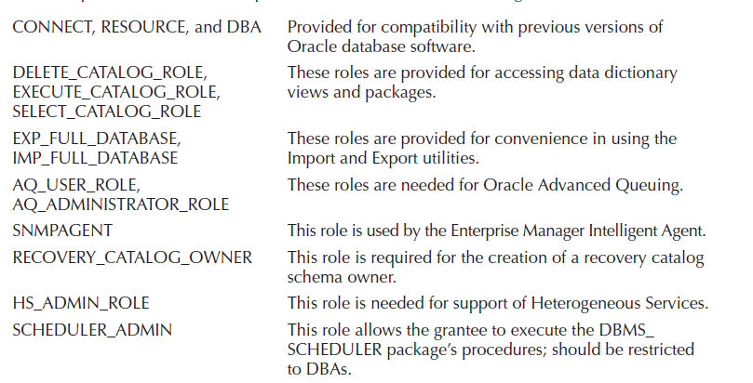
Roles
system privileges and object accesses into roles specific to your application users’ needs
  Dora has no system privileges other than CREATE SESSION
The most important standard roles created during database creation are:

Slide 12
Creating a Role
To create a role, you need to have the CREATE ROLE system privilege
  create role role_name
  [not identified
  |identified {by password | using [schema.]package
  |externally | globally }];
Examples:
  create role CLERK;
  create role MANAGER;

Slide 13
Granting Privileges to a Role
grant select on COMFORT to CLERK;
the role name takes the place of the username in the grant command.
The privilege to select from the COMFORT table will now be available to any user of the CLERK role.
Granting a Role to Another Role
  grant CLERK to MANAGER;
  grant CLERK to MANAGER with admin option;
If the with admin option clause is used, the grantee has the authority to grant the role to other users or roles.
  The grantee can also alter or drop the role.
Dropping a Role
  drop role MANAGER;
  drop role CLERK;
Can you grant manager to CLREK?????

Slide 14
grant
Oracle grant security takes several forms:
  object grants,
  system privilege grants, and
  role-based grants.
The idea is that every user in the database is granted access to specific data objects to control data access
You can grant any system privilege or role to another user, to another role, or to public.
The with admin option clause permits the grantee to bestow the privilege or role on other users or roles

Slide 15
Oracle Object privileges best practices
Object privileges assign the right to perform a particular operation on a specific object.
Here are some examples of object privilege assignment:
  grant select, insert on customer to fred, mary, joe;
  grant insert on order_table to update_role;
  grant all on customer to fred;
  grant select on customer_view to mary;

Slide 16
Grant Example: what can be granted?
create user Judy identified by sarah;
grant CREATE SESSION to Judy;
create user Bob identified by carolyn;
grant CREATE SESSION, CREATE TABLE, CREATE VIEW,
CREATE SYNONYM to bob;
alter user bob default tablespace users quota 5m on users;
This sequence of commands gives both Judy and Bob the ability to connect to Oracle, and gives Bob some extra capabilities.
Granting a Role to Users
  grant CLERK to Bob;

Slide 17
Grant Example: what can be granted?
The privileges a user can grant include these:
  On the user’s tables, views, and materialized views: INSERT, UPDATE (all or specific columns), DELETE, SELECT
  On tables, you can also grant: ALTER (table—all or specific columns), DEBUG, INDEX (columns in a table), ON COMMIT REFRESH, …, ALL (of the items previously listed)
  On procedures, functions, packages, abstract datatypes, libraries, indextypes, and operators: EXECUTE, DEBUG
  On sequences: SELECT, ALTER
  On directories (for BFILE LOB datatypes and external tables): READ, WRITE
  grant select on COMFORT to Bob;
The with grant option clause of the grant command allows the recipient of that grant to pass along the privileges he or she has received to other users

Slide 18
Revoking Privileges
Privileges granted can be taken away. The revoke command is similar to the grant command:
revoke {system privilege | role | all [privileges] }
[, {system privilege | role | all [privileges] }. . .]
from {user | role} [, {user | role}]. . .
Revoking everything from a given user does not eliminate that user from Oracle, nor does it destroy any tables that user had created; it simply prohibits that user’s access to them.
Other users with access to the tables will still have exactly the same access they’ve always had.
use the drop user command to remove a usr
  drop user username [cascade];
    The cascade option drops the user along with all the objects

Slide 19
Granting Access to the Public
Rather than grant access to every worker, the grant command can be generalized to the public:
    grant select on MY_CHECKOUT to public;
  This gives everyone access, including users created after this grant was made.
  However, each user will still have to access the table using the owner’s username as a prefix.
  `To avoid this, a DBA may create a public synonym (which creates a name accessible to all users that stands for Practice.MY_CHECKOUT):
    create public synonym MY_CHECKOUT for Practice.MY_CHECKOUT;

Slide 20
Security by User
To enable each borrower to access this table, but restrict the access given to a view of only each borrower’s own single row, you could create 19 separate views, each with a different name in the where clause, and you could make separate grants to each of these views for each borrower
Alternatively, you could create a view whose where clause contains User, the pseudo-column, like this:
    create or replace view MY_CHECKOUT as
    select * from BOOKSHELF_CHECKOUT
    where SUBSTR(Name,1,INSTR(Name,' ')-1) = User;
The where clause will find his or her username in the Name column (see the where clause) and return just that user’s records.

Slide 21
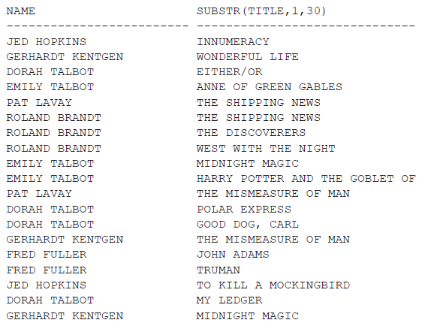
Security by User Example
select Name, SUBSTR(Title,1,30) from BOOKSHELF_CHECKOUT;

Slide 22
Security by User Example
In the following example, a user name Jed is created and granted access to the MY_CHECKOUT view. Selecting from that view yields just those books checked out by him
    create user jed identified by hop;
    grant CREATE SESSION to jed;
    grant select on MY_CHECKOUT to jed;
    select * from Practice.MY_CHECKOUT;
NAME TILE CHECKED OUT RETURNEDD
---- ----- ---------
JED HOPKINS INNUMERACY 01-JAN-02 22-JAN-02
JED HOPKINS TO KILL A 15-FEB-02 01-MAR-02
MOCKINGBIRD

